Slide 1
Machine Learning A brief History
Dr. Umberto Michelucci
umberto.michelucci@toelt.ai
(with slides form Dr. Daly, HSLU)

Slide 2
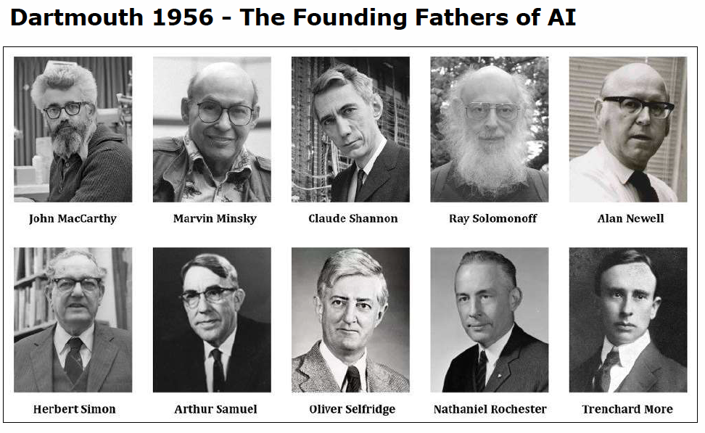
The Origins of AI
1945 | Worlds first programmable computer: ENIAC
1950 | Alan Turing: The Turing Test. Can a machine pass itself off as a human in its responses?
1956 | Dartmouth conference: official birth of AI
1960’s | The Golden Years: Interpret the human brain as a machine
“The study [of AI] is to proceed on the basis of conjecture that every aspect of learning or any other feature of intelligence can be so precisely described that a machine can be made to simulate it”
https://medium.com/rla-academy/dartmouth-workshop-the-birthplace-of-ai-34c533afe992

Slide 3
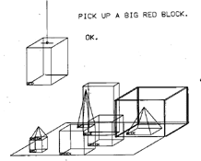
The Golden Years: Logic & Reasoning
1956 | Newell & Simon : 38 Proofs from Pinicipia Mathematica
1963 | DARPA gives MIT $2.2M for machine aided cognition
1964 | IBM Handwriting Recognition Demo at NY World Fair Write Date → Get Headlines Translate English Russian texts
1967 | Marvin Minsky: “Within a generation, the problem of creating AI will substantially be solved”
1970 | Terry Winnograd (MIT): Natural language processing for moving blocks in a Microworld
http://hci.stanford.edu/~winograd/shrdlu/

Slide 4
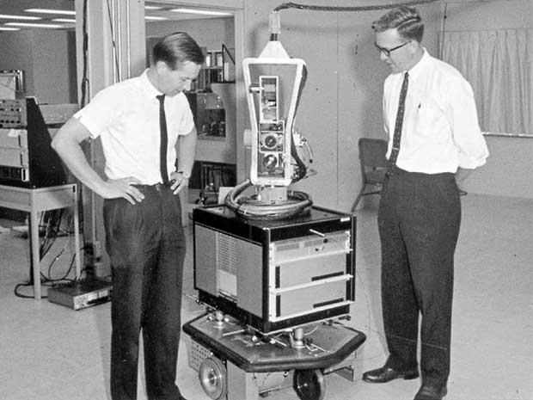
The First AI Winter
1970 | Minsky: In 3-8 years we will have a machine with the general intelligence of an average human
70-73 | AI mainly based on rule-based programming, fails to deliver on most promises
1973 | U.S. and British Governments stop funding undirected AI research
74-80 | The first AI Winter
Shakey, the First “Intelligent” Robot
The Stanford Research Institute 1966-1972
Moravec Paradox: ”It is easy to make computers exhibit adult level performance on intelligence tests or playing checkers, and difficult or impossible to give them the skills of a one-year-old when it comes to perception and mobility”
https://thenewstack.io/remembering-shakey-first-intelligent-robot/

Slide 5
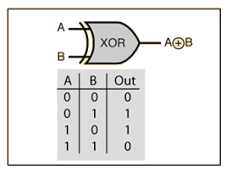
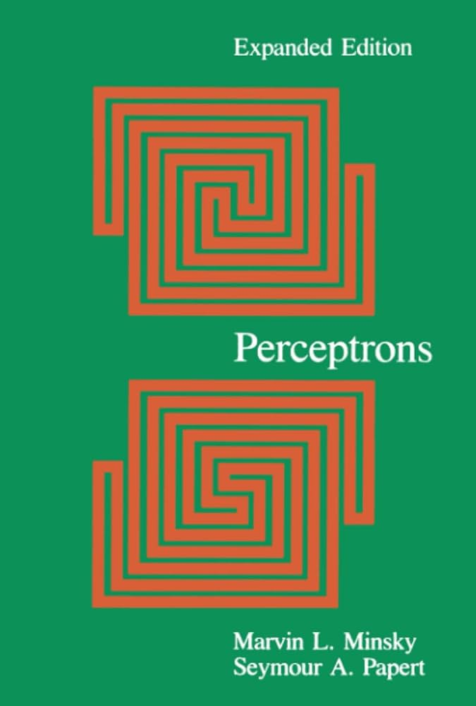
Famous book “perceptrons”
The book "Perceptrons" by Marvin Minsky and Seymour Papert, published in 1969, stands as a critical and influential work.
Minsky and Papert’s work provided a thorough mathematical critique of the perceptron, delving into its capabilities and, more importantly, its limitations.
The authors demonstrated that perceptrons, as they were then conceived, were incapable of solving some relatively simple but fundamental problems, such as the XOR problem, which involves correctly classifying inputs that are not linearly separable.

Slide 6
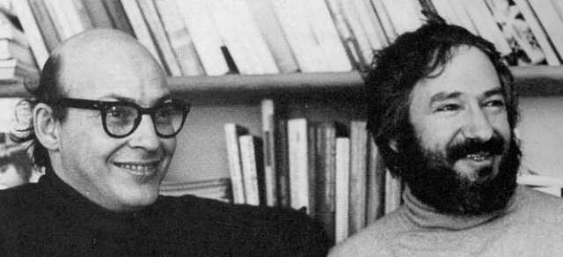
Famous book “perceptrons”
The criticism contained in "Perceptrons" was so compelling that it led to a significant reduction in interest and funding for neural network research.
This period, often referred to as the first "AI Winter," was characterized by skepticism and reduced expectations for the field of artificial intelligence.
https://www.npr.org/sections/ed/2016/08/05/488669276/remembering-a-thinker-who-thought-about-thinking
Marvin Minsky (left) and Seymour Papert (right) in 1971.

Slide 7
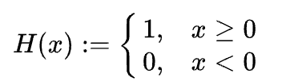
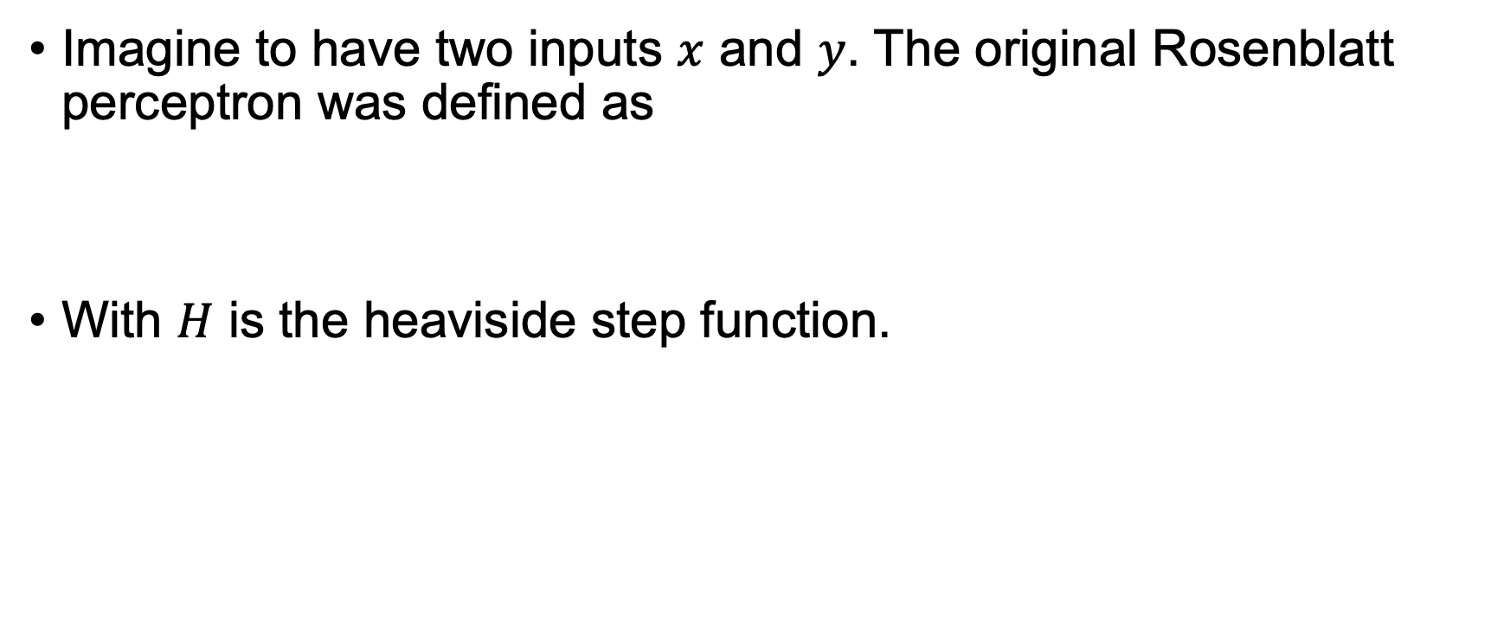
Perceptron
Imagine to have two inputs $x$ and $y$. The original Rosenblatt perceptron was defined as
With $H$ is the heaviside step function.

Slide 8
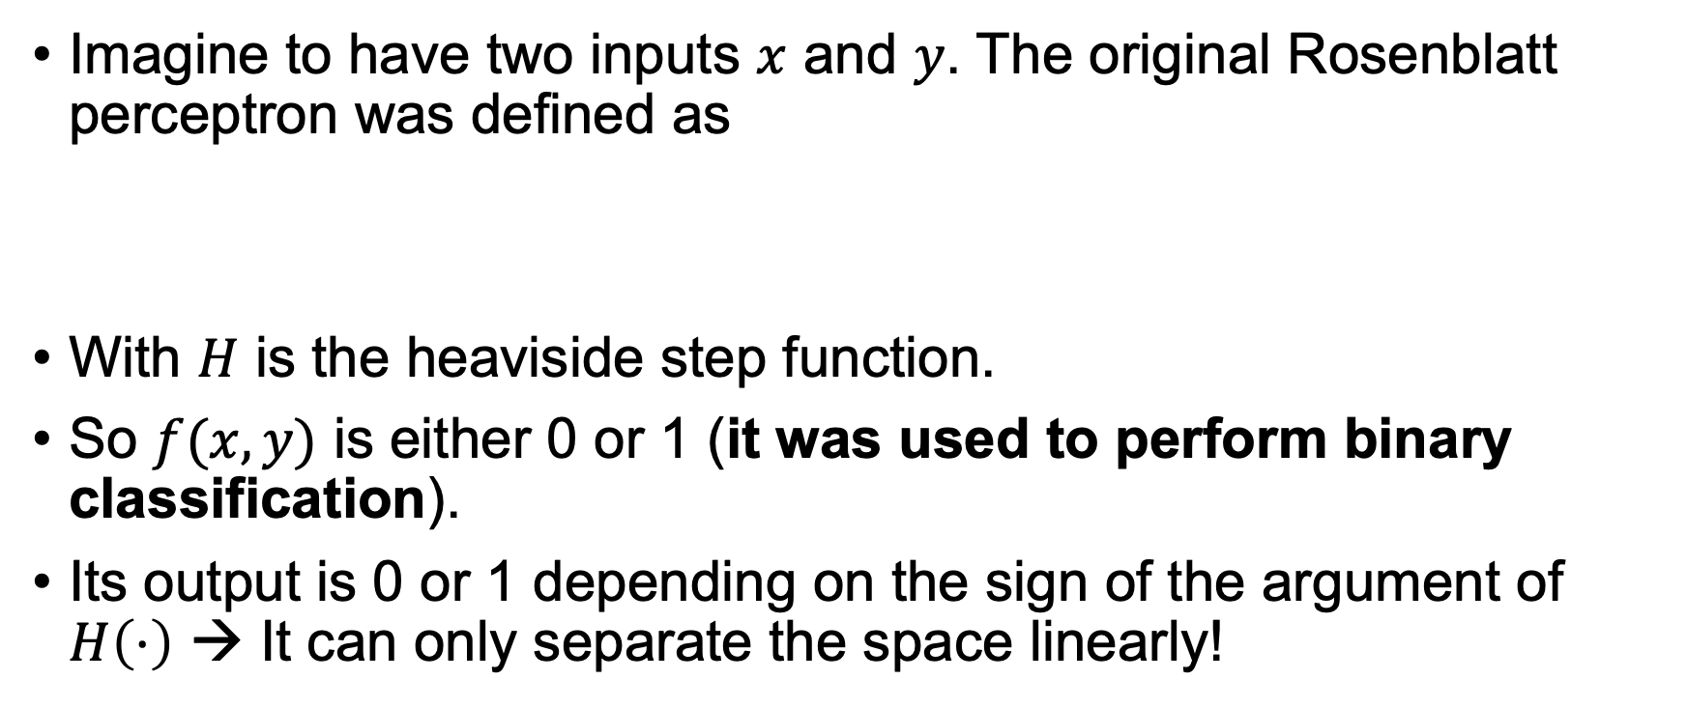
Perceptron
Imagine to have two inputs $x$ and $y$. The original Rosenblatt perceptron was defined as
With $H$ is the heaviside step function.
So $f(x,y)$ is either 0 or 1 (it was used to perform binary classification).
Its output is 0 or 1 depending on the sign of the argument of $H\left(⋅\right)$ → It can only separate the space linearly!

Slide 9
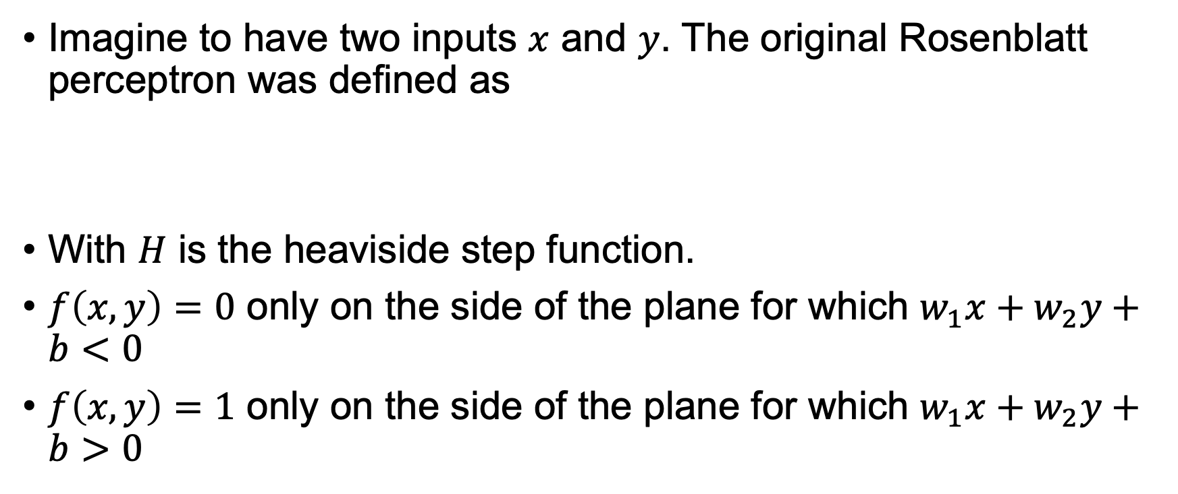
Perceptron
Imagine to have two inputs $x$ and $y$. The original Rosenblatt perceptron was defined as
With $H$ is the heaviside step function.
$f\left(x,y\right)=0$ only on the side of the plane for which $w_{1}x+w_{2}y+b<0$
$f\left(x,y\right)=1$ only on the side of the plane for which $w_{1}x+w_{2}y+b>0$

Slide 10
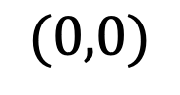
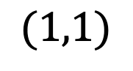
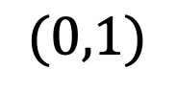
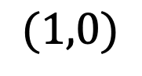
The XOR problem
CLASS 1
CLASS 0
$$(0,1)$$
$$(1,1)$$
No line can separate the plane in such a way that the two points in class 0 are on one side of the line and the points in class 1 on the other.
CLASS 0
CLASS 1
$$(0,0)$$
$$(1,0)$$

Slide 11
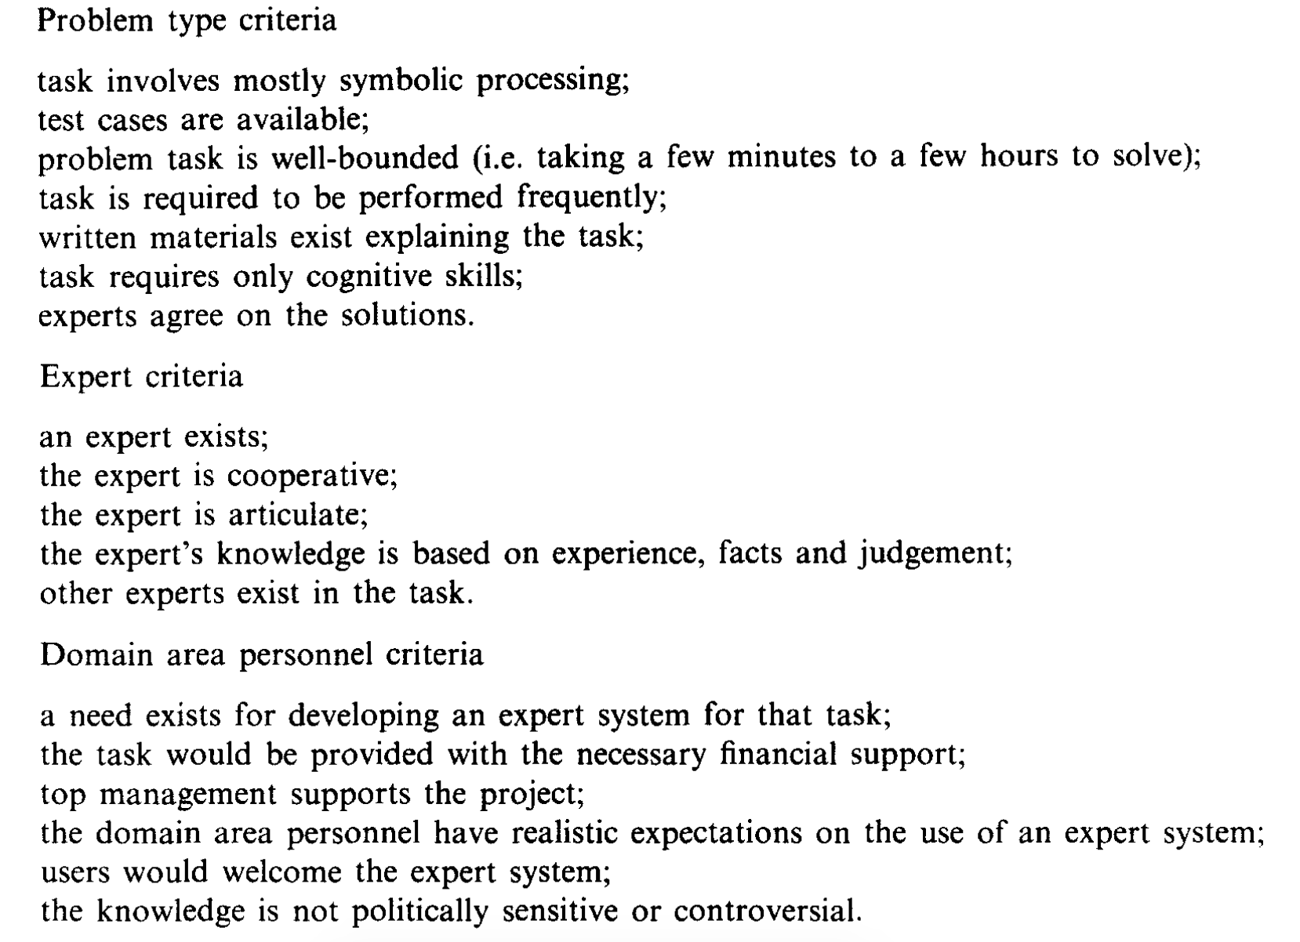
The Second Wave: Expert Systems
1970’s | Research on Expert Systems which augments reasoning with Knowledge
1980’s | Large-scale deployment: Two thirds of Fortune 500 companies used the technology in daily business.
1985 | Over $1B Spent on AI research & development by more than 150 companies
Expert Systems: Success Criteria
“Expert Systems: A Short Introduction”, Jay Liebowitz, 1995, Engineering Fracture Mechanics

Slide 12
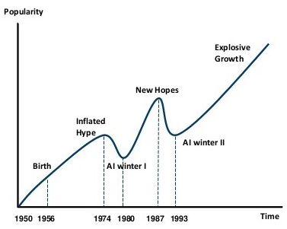
The Second AI Winter
“AI Winters”
1987 | Collapse of market for specialized AI hardware (LISP Machines)
87-89 | DARPA Funding Slashed by one third
89-92 | Most deployed systems fall into disuse
Steven Pinker “The main lesson of the first 35 years of AI research is that the hard problems are easy and the easy problems are hard”
https://www.actuaries.digital/2018/09/05/history-of-ai-winters/
“Early Expert Sytems, Where are they Now?” T.G. Gill, MIS Quarterly, 1995

Slide 13
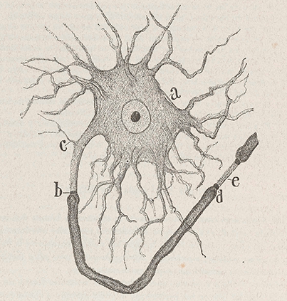
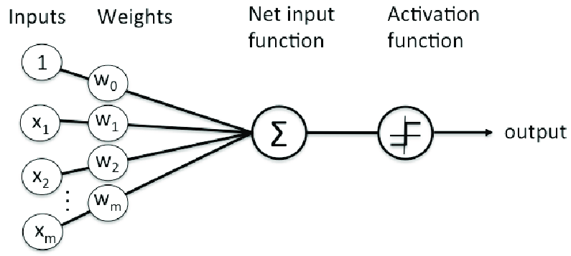
Networks that Learn
1887 | Santiago Ramón y Cajal at Uni. Barcelona discovers neurons as fundamental to the nervous system
1943 | McCulloch & Pitts model the neuron as a logic unit. Show that network of such neurons can do any computation.
1949 | Donald Hebb conceives an update Rule for learning: Neurons that fire together, wire together.
1958 | Frank Rosenblatt takes the ideas into computer research: he invents the Perceptron, a single layer neural network
Cajal’s sketch of a Neuron
Rosenblatt’s Perceptron
https://www.brainfacts.org/brain-anatomy-and-function/cells-and-circuits/2018/santiago-ramon-y-cajal-the-first-modern-neuroscientist
https://vitalflux.com/java-implementation-for-rosenblatt-perceptron/

Slide 14
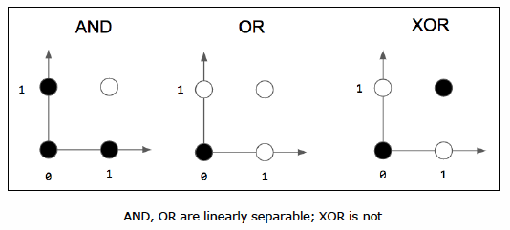
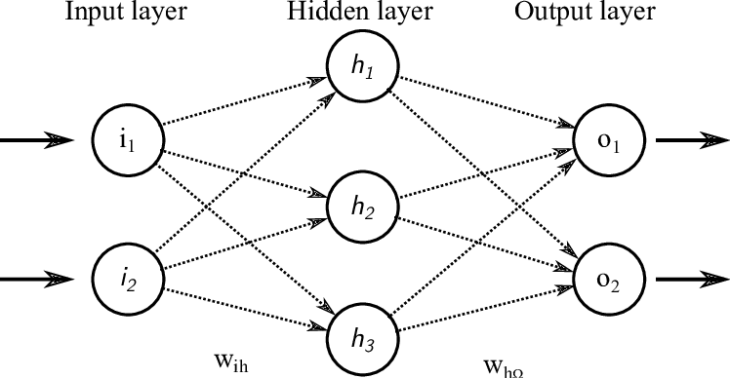
The Difficult Birth of Neural Networks
1969 | Minsky & Papert claim much scientific writing on Perceptrons is without scientific value
70’s | Rosenblatt dies. Rule-based programming dominates. Funding crashes. First AI-Winter.
80’s | Neural networks show promise and make comeback. By ‘91 there are >10k NN researchers in the U.S. alone.
1987 | Yann LeCun proposes modern form of back-propagation learning algorithm for ANNs
1993 | The Second AI Winter! ☹
The perceptron is a supervised binary linear classifier. Can you separate two groups using a straight line?
Neural networks with hidden layers can implement non-linear classification

Slide 15
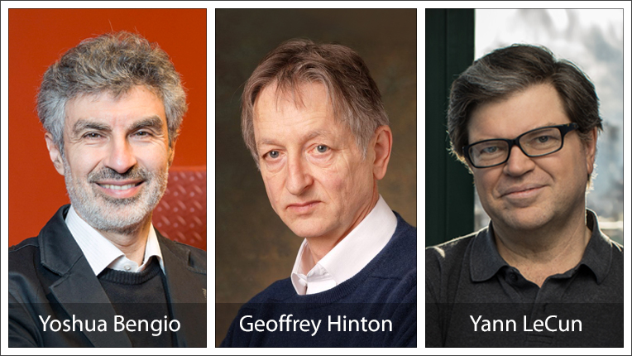
Deep Learning and the AI Boom
2005 | Geoffry Hinton exposes internal function of multi-layered Neural networks with many hidden units
2010 | Affordable GPUs give boost to large Neural Networks
2015 | Machines outperform humans at image recognition. Facebook launches DeepFace (9 layers, 120M params)
2016 | AlphaGo from DeepMind beats world champion Lee Sodol at Go
2020 | Open-AI releases GPT-3 language model with 175 Billion parameters
Turing Award 2018
Key Contribution:
Generative
Adversarial
Networks
Key Contribution:
Backpropagation allows NNs discover their own internal representations of data
Key Contribution:
Convolutional Neural Networks
https://awards.acm.org/about/2018-turing
“Artificial Intelligence in the 21st Century”, Kong et al., IEEE Acess, 2018

Slide 16
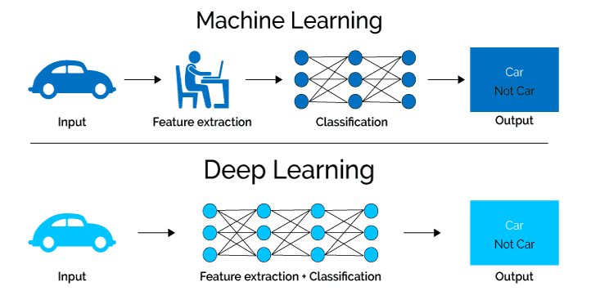
Deep Learning Using Many Layers
The core idea of deep learning is to exploit the ability of large neural networks to learn features within the data relevant to the task at hand
To do this we need lots of data, sophisticated
algorithms and lots of processing power
https://medium.com/@kuzuryu71/deep-learning-vs-machine-learning-7db5cfd75321

Slide 17
Three Pillars of Machine Learning:
Data, Algorithms & Processing Power

Slide 18


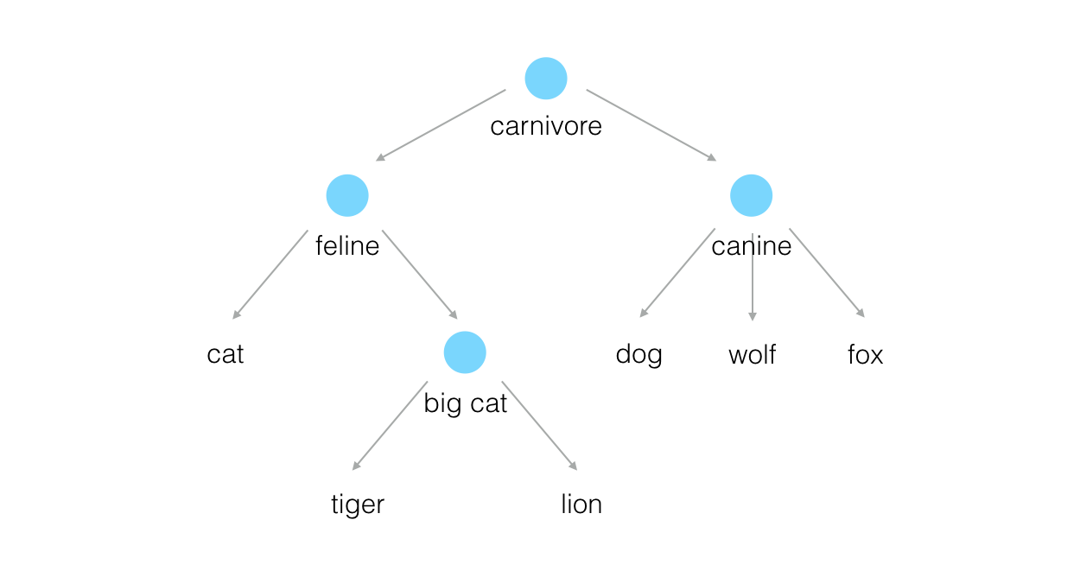
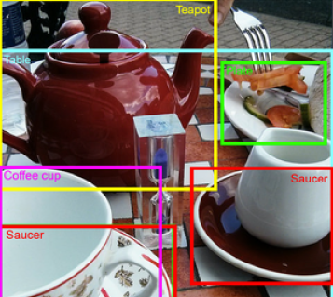
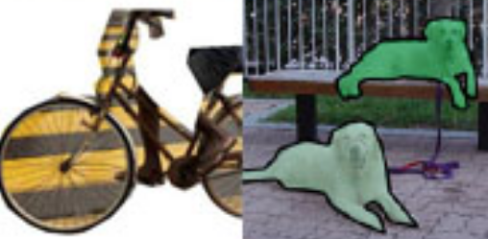
Example: Open Source Image Data
ImageNet
Coco Dataset
Open Images
Biggest and best known, out of Stanford
14M labelled images
1 Million images with bounding box notations
22k image categories, arranged by hierarchy
Common Objects in Context: backed by Microsoft and Facebook
A large-scale object detection, segmentation, and captioning dataset
~200k labelled images
Released by Google
~9M labelled images
object bounding boxes
object segmentation
visual relationships
https://zbigatron.com/the-top-image-datasets/

Slide 19




Open Source Algorithms Are Also Available
Tensorflow
Pytorch
Sonnet
Keras
Google’s TensorFlow is JavaScript-based and comes equipped with a wide range of tools and community resources that facilitate easy training and deploying Deep Learning
Open-source DL framework from Facebook. Designed to speed process from prototyping to production. It has a C++ frontend atop a Python interface
Developed by DeepMind, Sonnet is a high-level library designed for building complex neural network structures in TensorFlow.
Keras is fast and open source!. It can process massive volumes of data while accelerating the training time for models. Provides a Python interface to the TensorFlow library.
There are many more frameworks. It’s worth to check around depending on the needs of your project.
https://www.upgrad.com/blog/top-deep-learning-frameworks/

Slide 20
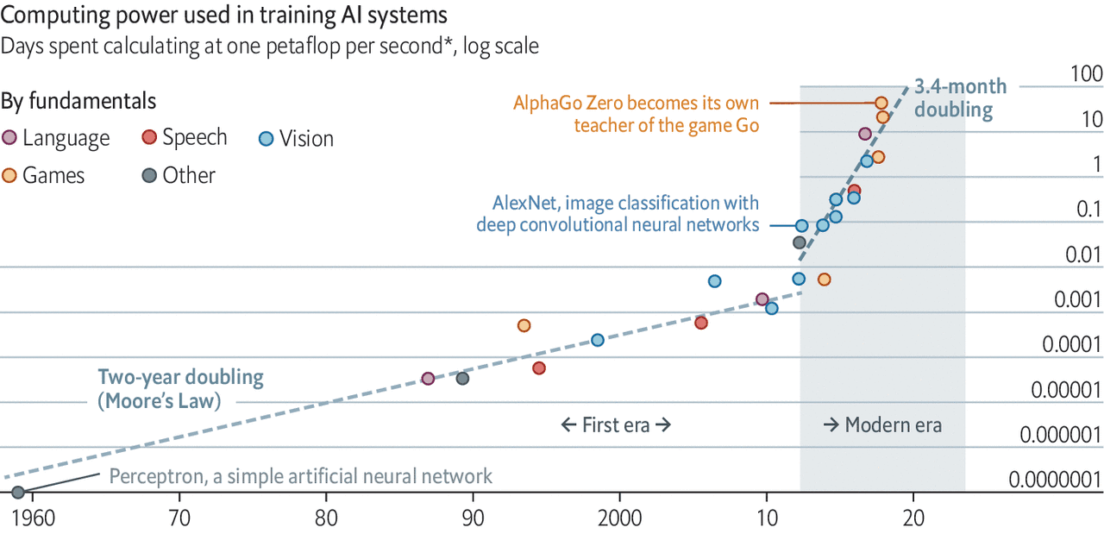
Deep Learning is Hungry for Computation
https://www.economist.com/technology-quarterly/2020/06/11/the-cost-of-training-machines-is-becoming-a-problem

Slide 21
Various Options for Hardware Acceleration
CPU
GPU
FPGA
ASIC
A Central Processing Unit is what you will find in your laptop or PC. General purpose, not so efficient.
E.g. Intel
Graphics Processing Unit, well suited for tensor calculations found in neural nets. Widely used.
E.g. NVidia
Field programmable gate array. Expensive to program, but lightning fast! Worth it for some applications.
E.g. Xilinx
Application specific integrated circuit. Dedicated silicon. Can’t be beaten for speed. Very costly!
E.g. Google TPU
Development Time
Quick and cheap
Long and expensive
Execution Time
Long! Runs more slowly
Short! Runs very fast

Slide 22
NVIDIA example of mid-range AI cards – the A6000 RTX
A6000 RTX – Price around 6-7000 USD
48 GB GDDR6 with error-correcting code (ECC)
New Tensor Float 32 (TF32) precision provides up to 5X the training throughput over the previous generation to accelerate AI and data science model training without requiring any code changes (a new datatype with varying precision before and after the comma).

Slide 23
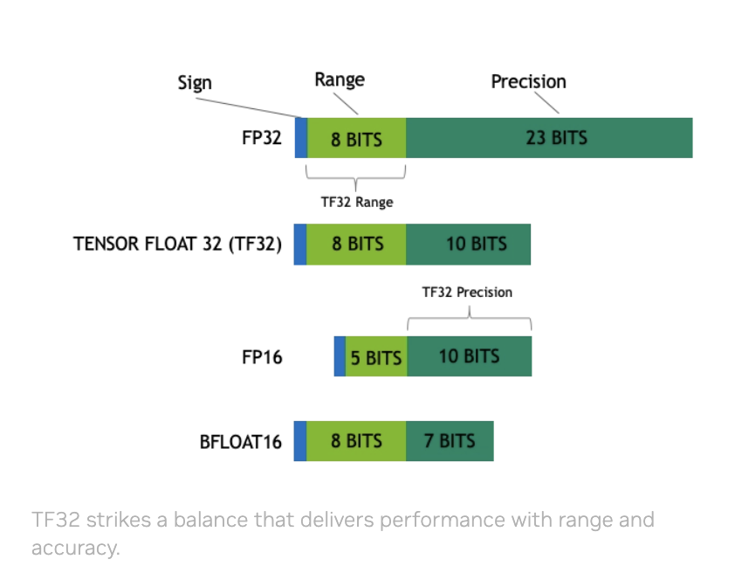
NVIDIA GPUs – Not only hardware
TensorFloat-32 is the new math mode in NVIDIA A100 and A6000 GPUs for handling the matrix math also called tensor operations used at the heart of AI and certain HPC applications. TF32 running on Tensor Cores in A6000/A100 GPUs can provide up to 10x speedups compared to single-precision floating-point math (FP32) on Volta GPUs.
https://blogs.nvidia.com/blog/tensorfloat-32-precision-format/#:~:text=TensorFloat%2D32%20is%20the%20new,(FP32)%20on%20Volta%20GPUs.

Slide 24
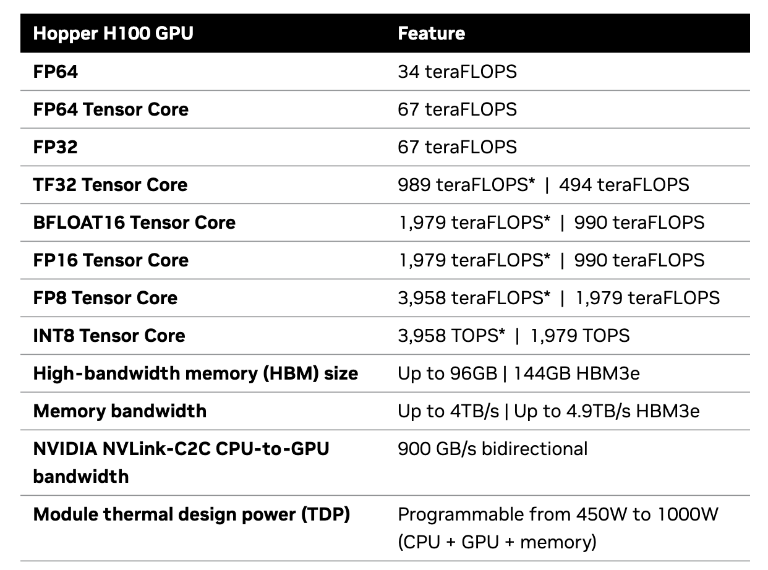
NVIDIA and GPUs – Latest and best
The new platform announced uses the Grace Hopper Superchip, which can be connected with additional Superchips by NVIDIA NVLinkTM, allowing them to work together to deploy the giant models used for generative AI.
This high-speed, coherent technology gives the GPU full access to the CPU memory, providing a combined 1.2TB of fast memory when in dual configuration.
New 900 gigabytes per second (GB/s) coherent interface.
Up to 480GB of LPDDR5X memory with error-correction code (ECC).
https://resources.nvidia.com/en-us-grace-cpu/grace-hopper-superchip

Slide 25




Processing Power Available in the Cloud
Colab
AWS
Azure
IBM Cloud
Google Colab allows you to write and execute Python in your browser with
zero configuration, free access to GPUs, and easy sharing
Amazon Web Services enables deep learning in the cloud at scale. You can quickly train custom AI models, with new algorithms.
GPUs are now part of Microsoft's cloud platform, ideal for the neural networks underpinning much of modern machine learning
IBM Cloud offers GPUs on bare metal and virtual servers. Design and deploy neural networks at scale within IBM Watson Studio
Quick and cheap
The international cloud computing landscape is highly dynamic and changing rapidly.
Switzerland has its own national providers such as Switch.ch for universities
Long! Runs more slowly
Short! Runs very fast

Slide 26
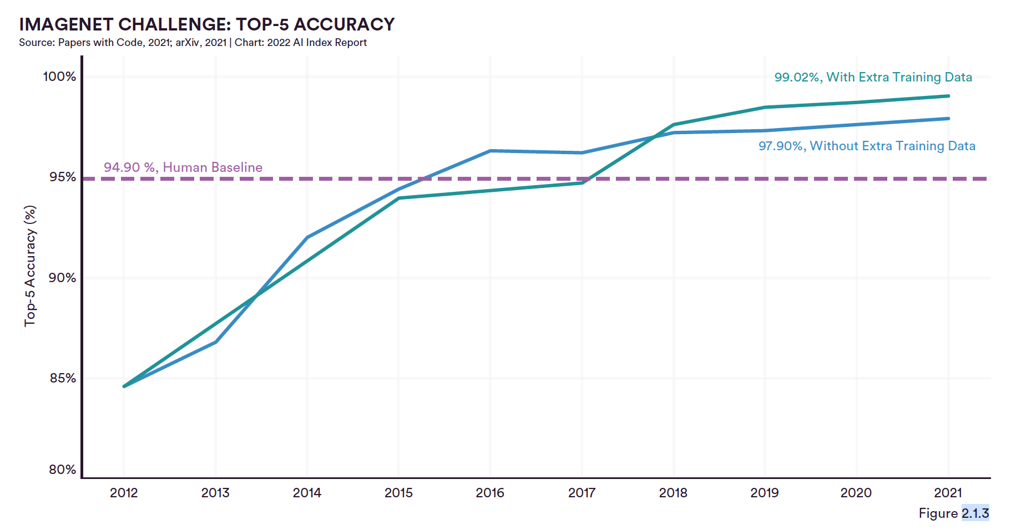
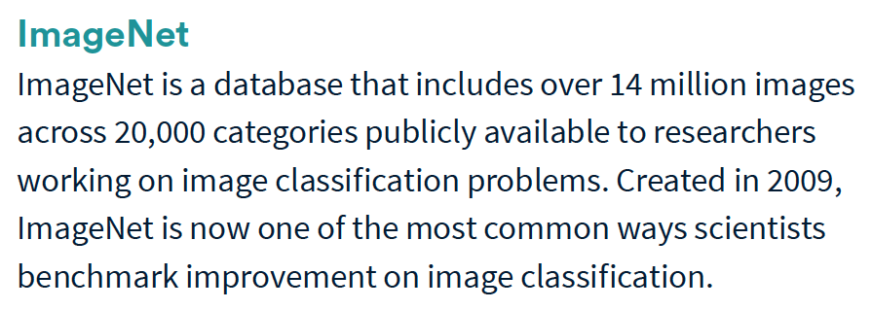

Slide 27
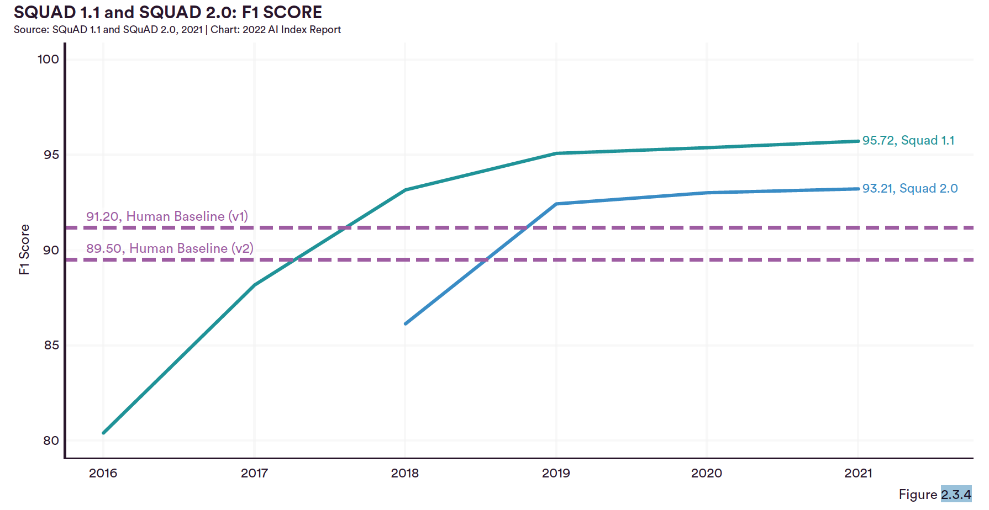
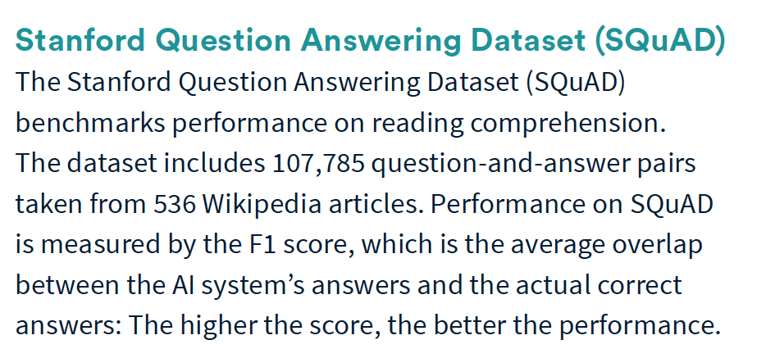

Slide 28
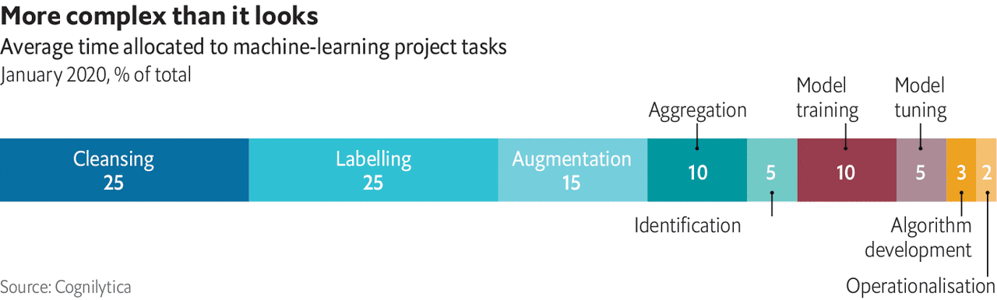
ML Projects remain Challenging
Data issues are one of the most common sticking-points in real AI projects
Up to 80% of project time is spent on the data and < 20% on ML models!
https://www.economist.com/technology-quarterly/2020/06/11/for-ai-data-are-harder-to-come-by-than-you-think

Slide 29

Training of Large ML Models is Energy Intensive
In 2019 researchers at Uni. Amherst estimated that training one version a big language model, could cost as much as $3m.
In 2020 an algorithm capable of learning, through trial and error, how to manipulate the pieces of a Rubik's Cube using a robotic hand consumed about 2.8 gigawatt-hours of electricity in its training
Facebook’s head of AI, says that one round of training for the biggest models can cost “millions of dollars” in electricity consumption.
Researchers estimate that the training of GPT-3, which ChatGPT is partly based on, consumed 1.3 GWh, and led to emissions of more than 550 tons of carbon dioxide equivalent
https://www.wired.com/story/ai-great-things-burn-planet/
https://www.wired.com/story/the-generative-ai-search-race-has-a-dirty-secret/

